Slide 1
Data Analytics BootCamp
ETL Mini-Project

Slide 2
Extract
Data Analytics Bootcamp
ETL Mini-Project

Slide 3
Extract: Original Data Sources
Crimes in Boston
Context
Crime incident reports are provided by Boston Police Department (BPD) to document the initial details surrounding an incident to which BPD officers respond. This is a dataset containing records from the new crime incident report system, which includes a reduced set of fields focused on capturing the type of incident as well as when and where it occurred.
Content
Formatted in CSV, records begin in June 14, 2015 and continue to September 3, 2018.
2. US Census Demographic Data
Context
Taken from the DP03 and DP05 tables of the 2015 American Community Survey, this data set contains information from the entire country. The full datasets and much more can be found at the American Factfinder website.
Content:
Two data files are contained in this data-set:
-acs2015_census_tract_data.csv: Data for each census tract in the US, including DC and Puerto Rico.
-acs2015_county_data.csv: Data for each county or county equivalent in the US, including DC and Puerto Rico.
The two files have the same structure, with just a small difference in the name of the id column. Counties are political subdivisions, and the boundaries of some have been set for centuries. Census tracts, however, are defined by the census bureau and will have a much more consistent size. A typical census tract has around 5000 or so residents.

Slide 4
Transform
Data Analytics Bootcamp
ETL Mini-Project

Slide 5
Transform: Clean-up Process
When performing a preliminar analysis of the data-sets, it became clear that both provided information about location. Through this data it was feaseable to merge both sets to perform an analysis of the most frequent crime types by poverty index, race, work status and type of work, amongst others.
1. Crimes in Boston
-Add ISO-8859-1 encoding to read the Crimes in Boston data set.
-Add County data to Crimes in Boston data set
-Select date/time related information for analysis.
2. US Census Demographic Data
-Remove all data not pertaining to the state of Massachussets.
-Remove all data not pertaining to the county of Suffolk.
-Select income, race, gender, employment and poverty information for analysis.
Final Transformation
After loading to the database, merge and perform the analysis.

Slide 6
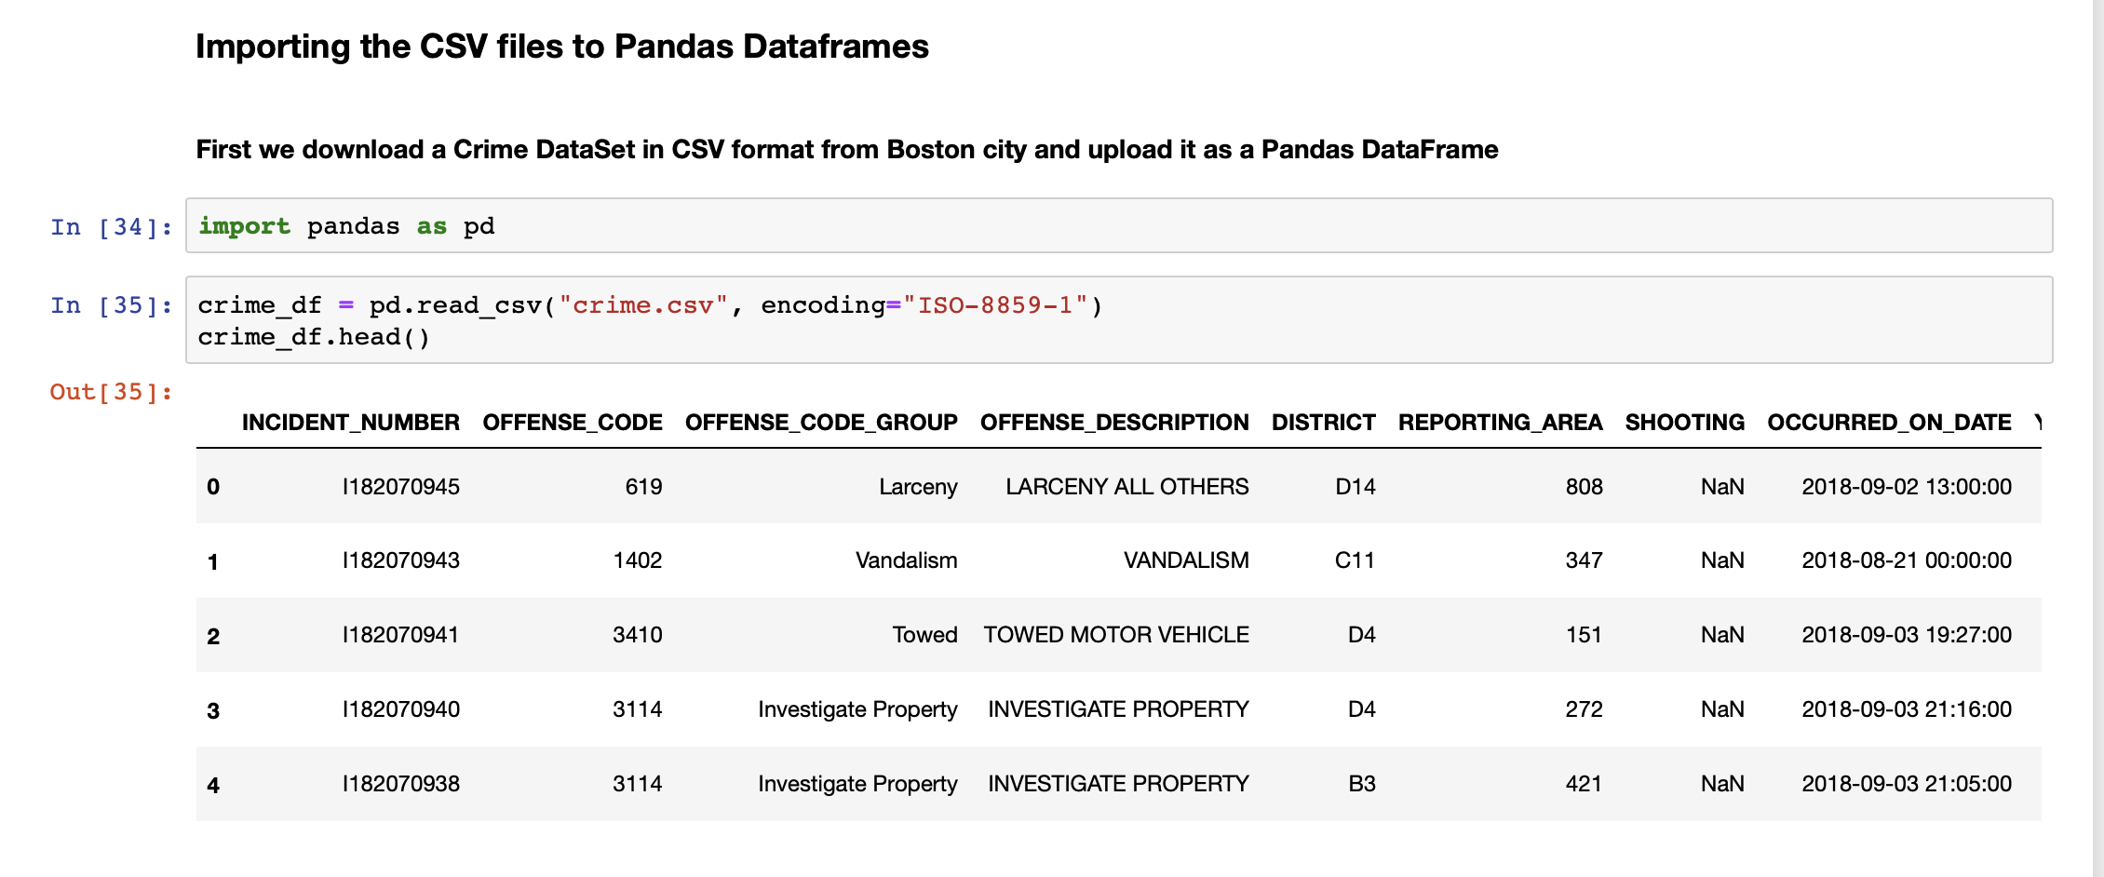

Slide 7
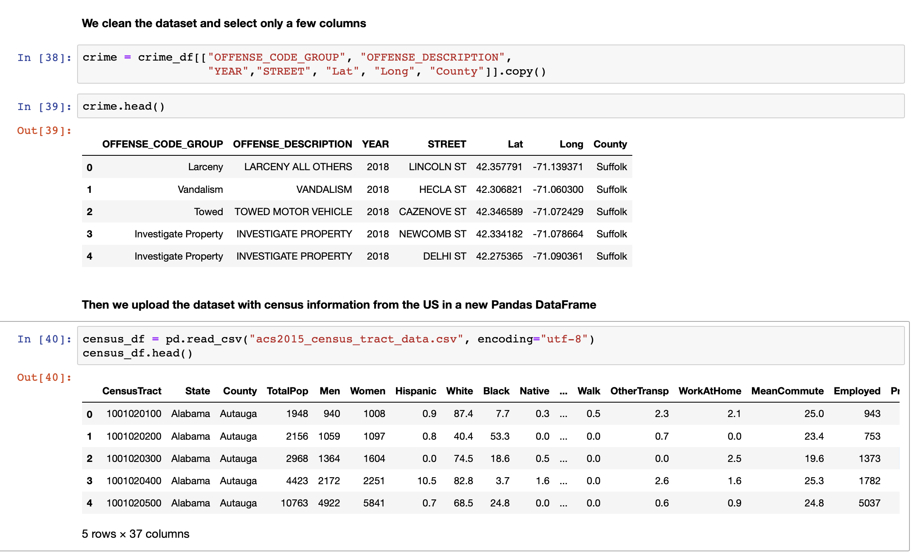

Slide 8
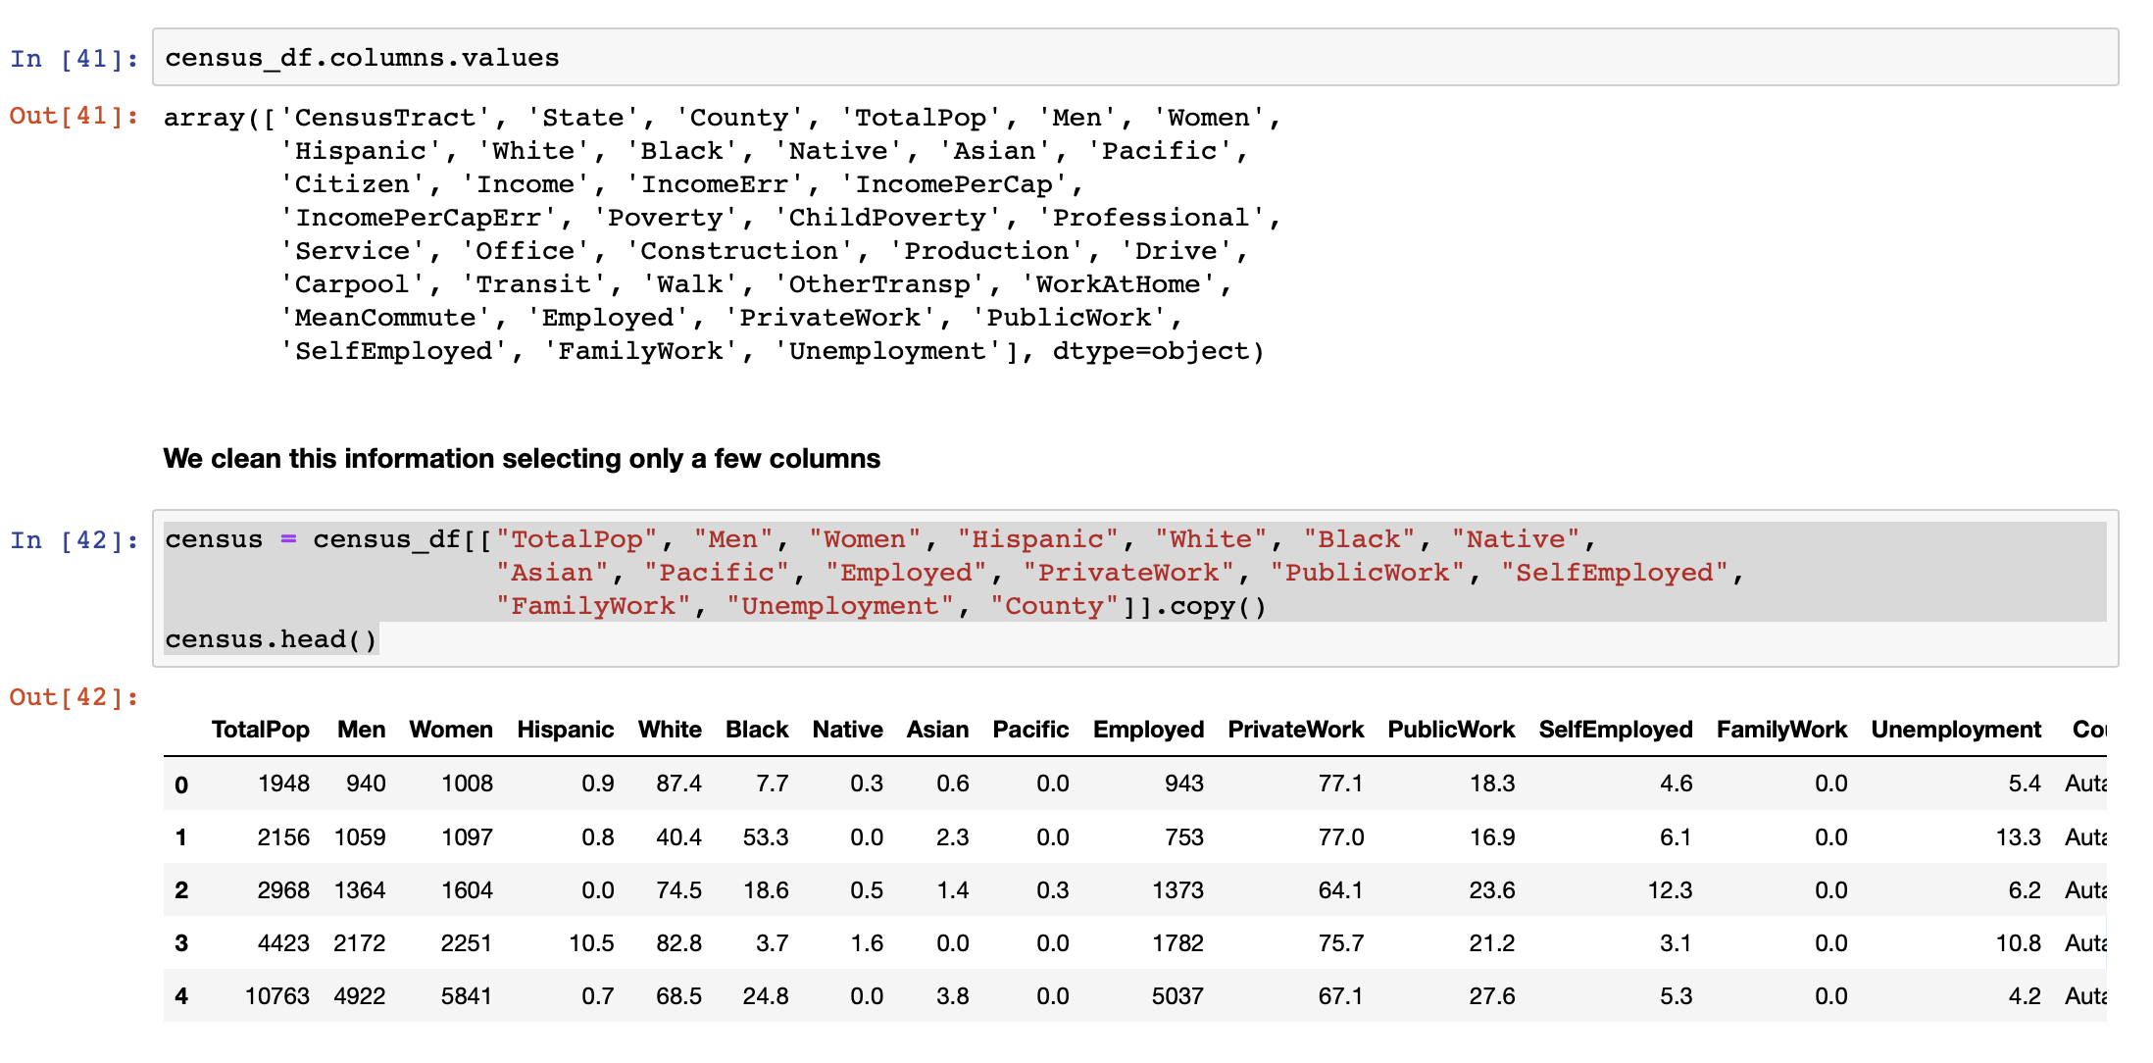

Slide 9

Load
Data Analytics Bootcamp
ETL Mini-Project

Slide 10
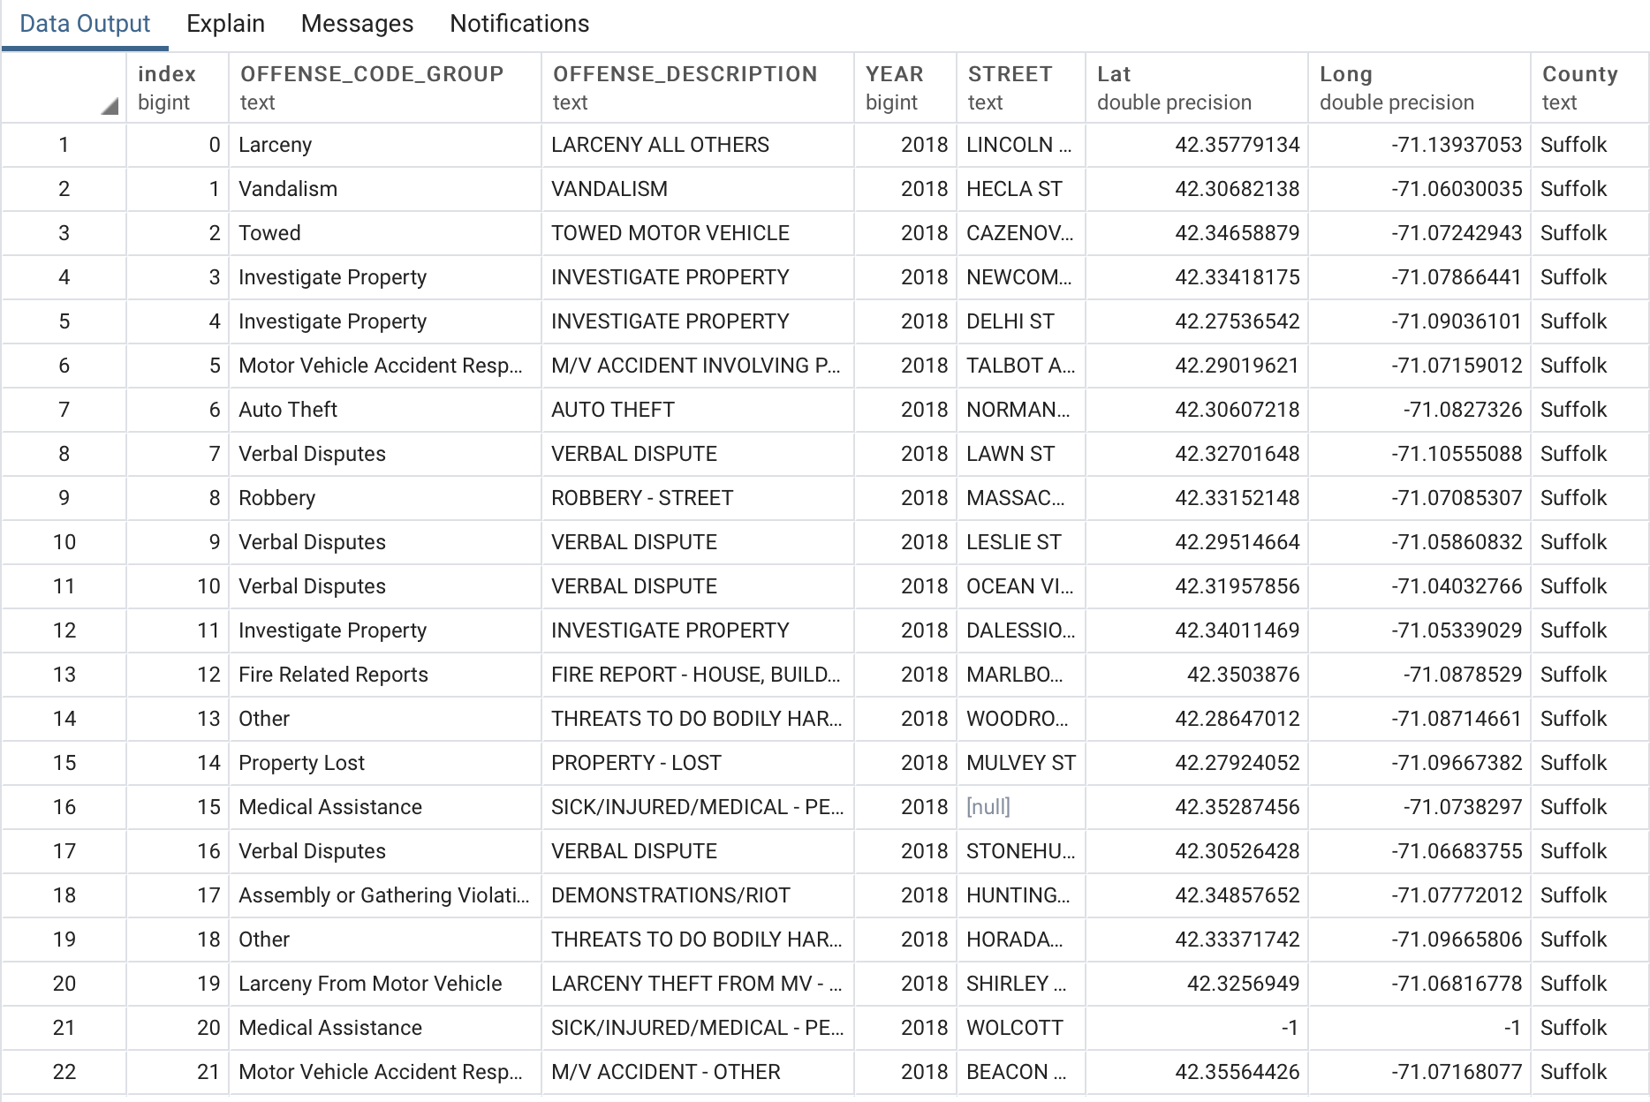
Load: The Final Database
Because we are dealing with stuctured, numeric information, we determined that a relational database was optimal for our purpose. We decided on Postgre to practice the use of this data base.

Slide 11
Thank you

